Slide 1
You’re probably lying about homelessness
CAEH Conference 2023

Slide 2
Ali Ryder, MES, RPP
HIFIS Guru
Owner of ACRE Consulting
Master’s in urban planning (social planning)
Previous experience with OrgCode Consulting, Inc. and City of Kingston
Coach with Canadian Alliance to End Homelessness (CAEH)
www.acreconsulting.ca
ali@acreconsulting.ca

Slide 3
You’re probably lying about homelessness
But it’s not your fault.
Homelessness is complicated!
Notes:
You’re probably lying about homelessness, but that’s okay, because it’s not your fault.
Homelessness is complicated! And it’s hard to make a definitive statement about it that’s 100% right. In fact, since you sat down in this room, the number of people experiencing homelessness in Canada has probably changed.
In this presentation, I am going to show how both 20% and 60% of homeless people were experiencing chronic homelessness.
I’m also going to show how both 6 months and 2 weeks is the average length of time people spend being homeless.
Confused? I’m not surprised.
I’ve heard us data people referred to as wizards, magicians. And you know how they say a magician never reveals her tricks? Well today you’re in for a special treat.

Slide 4
3 Methods to Obfuscate and Confuse
Notes:
Today, I will present to you 3 methods to obfuscate and confuse your audience.
I present them so that you can learn these tricks, and start to recognize them both in your own work, in the media, and maybe even at this very conference.
You will learn these techniques not in the hope that you will use them, but in the hope that you will learn from them, allowing you to be able to engage with your data more effectively.

Slide 5
Disclaimer
In this presentation I use real world data that does not always paint a flattering picture. I am not picking on anyone in particular, and I try to pick on lots of different communities equally. In fact, some of the sources I use are actually very good.
My point is that any data can be taken out of context and misrepresented.
All this data is publicly available and published online. If you are uncomfortable with my use of your data, email me: ali@acreconsulting.ca

Slide 6
Method 1:
Present meaningless data without explaining it

Slide 7
“86% of people surveyed fall between the ages of 18-54”
2018 Charlottetown Point in Time Count
Notes:
How often have you heard a presentation or read an article that gives you a statistic like this one: “the average age of people experiencing homelessness… was 31 years”? The stat is presented to you on its own as if it is meaningful on its own. But what is it trying to tell you?

Slide 8
What does this say?
Okay, so most of the people surveyed were adults. But why is that important?
What does this say about homeless children in families or unaccompanied youth? Does it mean that there aren’t many, or just that we didn’t survey them?
Does it mean that we are doing a good job at addressing senior homelessness? Or are all the homeless seniors dying early? Or maybe there’s a lot of senior homelessness?
Without some more context, this data point is not helpful.

Slide 9
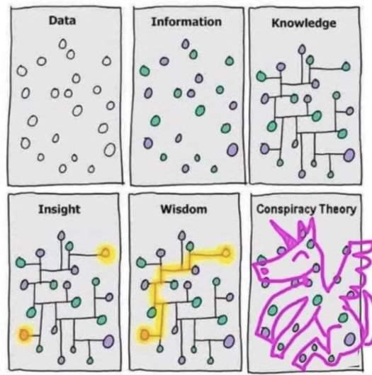
Raw Data is not Helpful

Slide 10
Key Takeaway:
Always ask what a data point means.

Slide 11
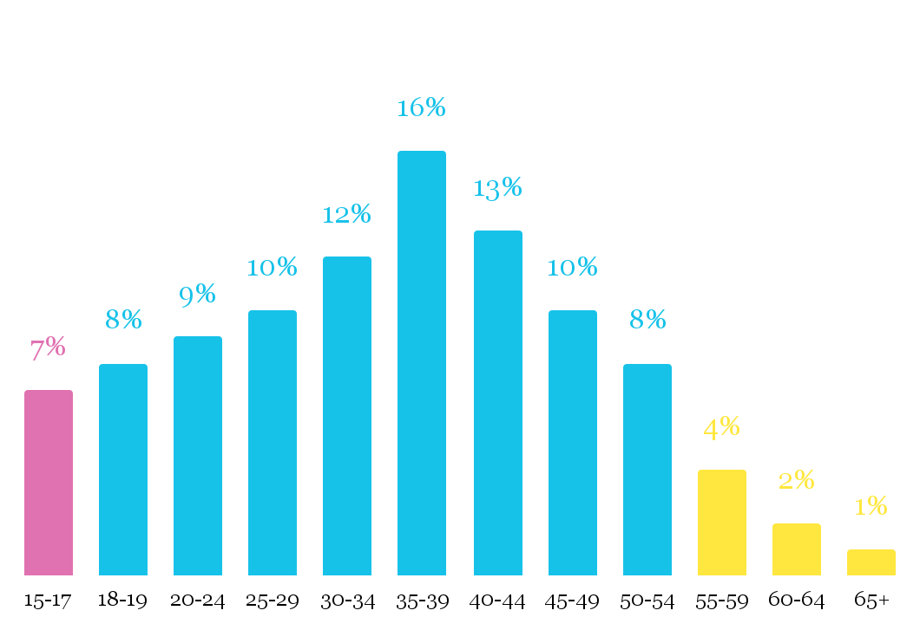
Alternate Version
“86% were aged 18-54”

Slide 12
Method 1b:
Present meaninglessful data without explaining it

Slide 13
“22% said that they [had Indigenous ancestry or status]”
2018 Halifax Point in Time Count Report

Slide 14
What does this say?
Again, we ask: is 22% a big number or a small number?
If you’re in Waterloo, ON, this looks big: their data shows 11% are Indigenous.
If you’re in Saskatoon, SK, this looks tiny: their most recent PIT showed 85% reporting Indigenous identity.
Just presenting this data point on its own, without a comparison, leaves readers guessing.

Slide 15
Key Takeaway:
When you’re not sure the significance of data, look for a comparison.

Slide 16
Alternate Version
“22% of homeless people reported Indigenous identity, compared to only 4% of the general population”
“22% reported Indigenous identity”

Slide 17
Method 1c:
Mix meaningful and meaningless data together!

Slide 18
“56% were male, 42% were female, 8% identified as LGBTQ2S. 17% were Indigenous or had Indigenous ancestry, 35% identified as being part of a racial group other than White...”
I Count: York Region’s 2018 Point in Time Count

Slide 19
“...4% were refugees or refugee claimants, 12% were immigrants, 80% were not immigrants or refugees. 26% were youth (aged 16-24).”
I Count: York Region’s 2018 Point in Time Count

Slide 21
Key Takeaway:
A wall of data overwhelms your readers.

Slide 22
Method 2:
Abuse mean and median to your advantage

Slide 23
“188 days: The average length of time people spent homeless within the past year”
Results of the Urban Kingston 2018 Point-in-Time Count

Slide 24
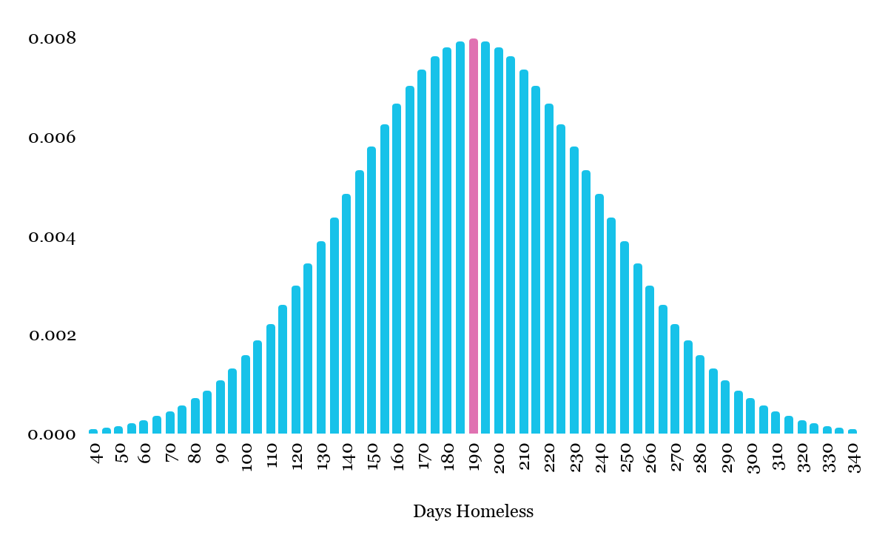
Most people hear “average” and think bell curve
WRONG
188-day average

Slide 25
Huh?

Slide 26
Crash Course in Grade 6 Math
Assuming the set of numbers: 1, 2, 3, 24, 70
The average (also called mean) is: (1+2+3+24+70) / 5 = 100 / 5 = 20
The median is the middle value: 1, 2, 3, 24, 70 = 3

Slide 27
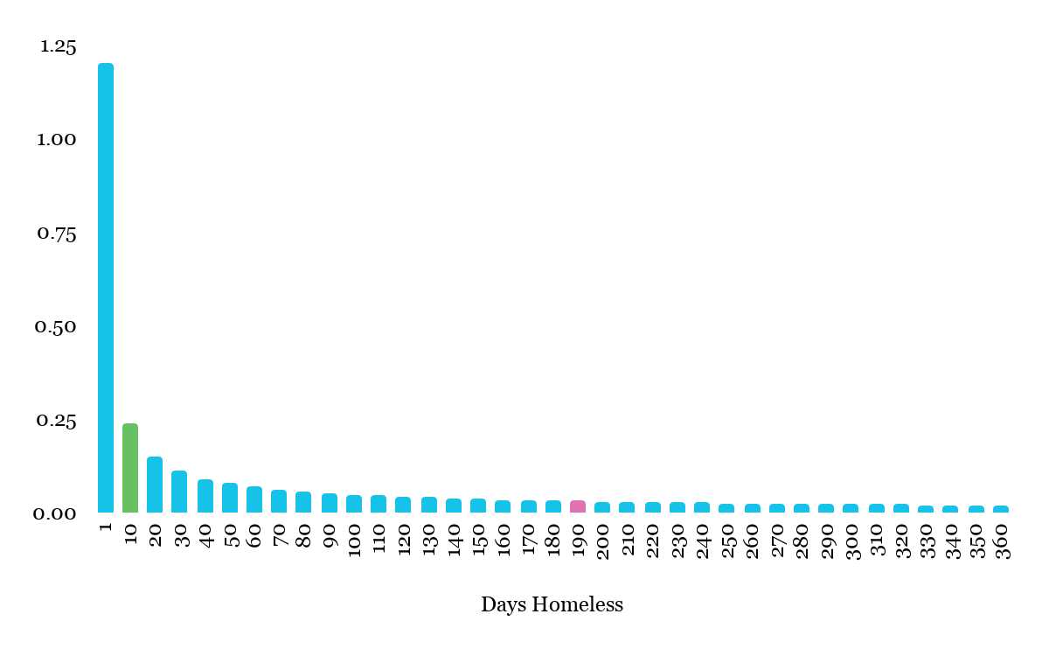
Power Law Curve
15-day median
188-day mean

Slide 28
Key Takeaway:
When you have a few extreme data points, averages are affected but medians are not.

Slide 29
Alternate Version
“The typical length of time people spent homeless in the last year was 15 days, but some were homeless much longer”
“The average length of time people spent homeless in the last year was 188 days”

Slide 30
Method 3:
Cherry-pick your data source

Slide 31
“In 2018, 22.3% of shelter users in the sample met the criteria for experiencing chronic homelessness.”
National Shelter Study 2018 Update

Slide 32
“People experiencing chronic homelessness accounted for 60% of all respondents”
Everyone Counts 2018

Slide 33
How does that make sense?

Slide 34
Look at the data sources
“In 2018, 22.3% of shelter users in the sample met the criteria for experiencing chronic homelessness.”
National Shelter Study 2018 Update
“People experiencing chronic homelessness accounted for 60% of all respondents”
Everyone Counts 2018
Data from the whole year
Data from just one day

Slide 35
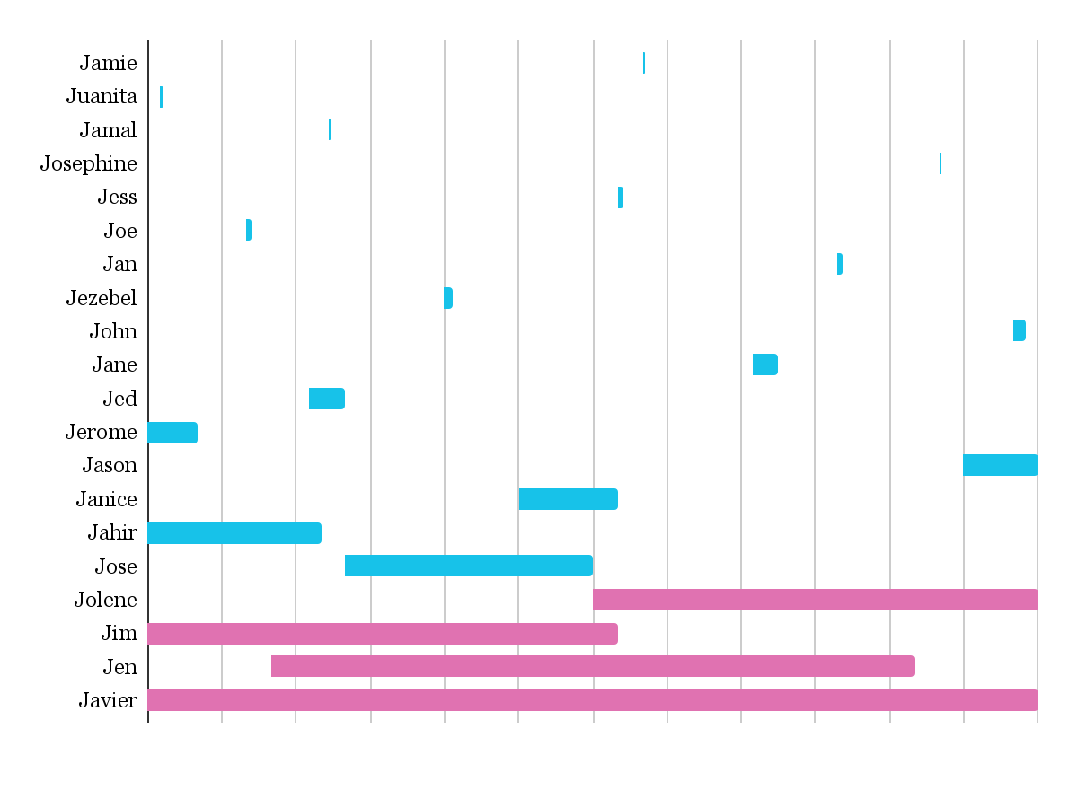
Over Time
J | F | M | A | M | J | J | A | S | O | N | D
Homelessness from January to December
4/20 (20%) are chronically homeless

Slide 36
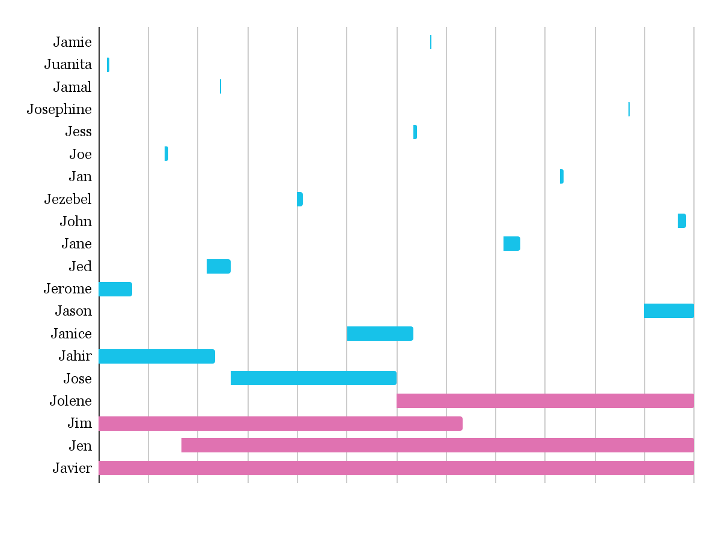
Point in Time
J | F | M | A | M | J | J | A | S | O | N | D
Homelessness on May 1
3/5 (60%) are chronically homeless

Slide 37
Key Takeaway:
You get very different data at a point in time versus over time.

Slide 38
Alternate Version
“20% of those who become homeless experience chronic homelessness, but that proportion is rising.”
“60% were chronically homelessness”

Slide 39
Method 3b:
Make your percentages big!

Slide 40
“More than half of respondents had not completed high school, only had primary or did not have formal education.”
Winnipeg Street Census 2022

Slide 41
Sounds like…
J | F | M | A | M | J | J | A | S | O | N | D
✔
✘
✔
✘
✔
✘
✔
Every second person didn’t finish school
(10/20)
✘
✔
✘
✔
✘
✔
✘
✔
✘
✔
✘
✔
✘

Slide 42
It’s probably more like…
J | F | M | A | M | J | J | A | S | O | N | D
✔
Most homeless people have finished school (15/20)
✔
✔
✔
✔
✔
✔
✔
✔
✘
✔
✔
✔
✘
Most chronically homeless people did not (3/4)
✔
✔
✘
✘
✔
✘

Slide 43
Key Takeaway:
Chronic homelessness is overrepresented in Point in Time Counts.

Slide 44
Alternate Version
“Chronically homeless respondents were 4x more likely to have not completed high school”
“More than half of respondents had not completed high school”

Slide 45
Method 3c:
Make your numbers big!

Slide 46
“Number of Canadians who used an emergency shelter [in 2018]: 137,000”
The National Shelter Study 2005-2014

Slide 47
That’s more than my entire hometown!

Slide 48
Key Takeaway:
The longer the period of time, the bigger the numbers will be.

Slide 49
Alternate Version
“About 14,000 people were staying in shelters on an average day last year”
“137,000 used an emergency shelter last year”

Slide 50
Method 3d:
Mix and match your data sources

Slide 51
“Number of Canadians who used an emergency shelter: 137,000”
+
“People experiencing chronic homelessness accounted for 60% of all respondents”

Slide 52
That’s 82,000 chronically homeless people!

Slide 53
Key Takeaway:
Be very careful when combining data from different sources.

Slide 54
Key Takeaways
Ask what the data point means. Find a comparison.
Avoid a wall of data.
Remember: averages are skewed by extreme values, but medians are not.
Ask whether a data point is from a point in time or from a longer period.
Chronic homelessness is overrepresented in point in time counts.
Avoid combining data from different sources.
Notes:
I’m sure that everyone in this room wants to understand homelessness a little bit better, and to be able to communicate effectively about homelessness to others.

Slide 55
Victims Sources
Prince Edward Island 2018 PiT Count Executive Summary Report
Everyone Counts: Report on the 2018 Halifax Point in Time Count
I Count: York Region's 2018 Homeless Count
Results of the Urban Kingston 2018 Point-in-Time Count
National Shelter Study 2018 Update
The National Shelter Study 2005-2014
Everyone Counts 2018
Winnipeg Street Census 2022

